Slide 1
6.7 Graphing Inequalities in Two Variables

Slide 2
Sidney is given $20 a week for allowance. She wants to spent her money at target buying socks, which cost an average of $2, and pens, which cost an average of $4. What can Sidney buy without going over budget?

Slide 3
Sidney is given $20 a week for allowance. She wants to spent her money at target buying socks, which cost an average of $2, and pens, which cost an average of $4. What can Sidney buy without going over budget?
Cost of socks plus closet of pens is less than or equal to $20

Slide 4
Sidney is given $20 a week for allowance. She wants to spent her money at target buying socks, which cost an average of $2, and pens, which cost an average of $4. What can Sidney buy without going over budget?
Cost of socks plus closet of pens is less than or equal to $20
2x + 4y < 20

Slide 5
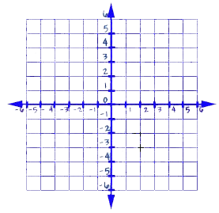
Sidney is given $20 a week for allowance. She wants to spent her money at target buying socks, which cost an average of $2, and pens, which cost an average of $4. What can Sidney buy without going over budget?
Cost of socks plus closet of pens is less than or equal to $20
2x + 4y < 20

Slide 6
Sidney is given $20 a week for allowance. She wants to spent her money at target buying socks, which cost an average of $2, and pens, which cost an average of $4. What can Sidney buy without going over budget?
Cost of socks plus closet of pens is less than or equal to $20
2x + 4y < 20

Slide 7
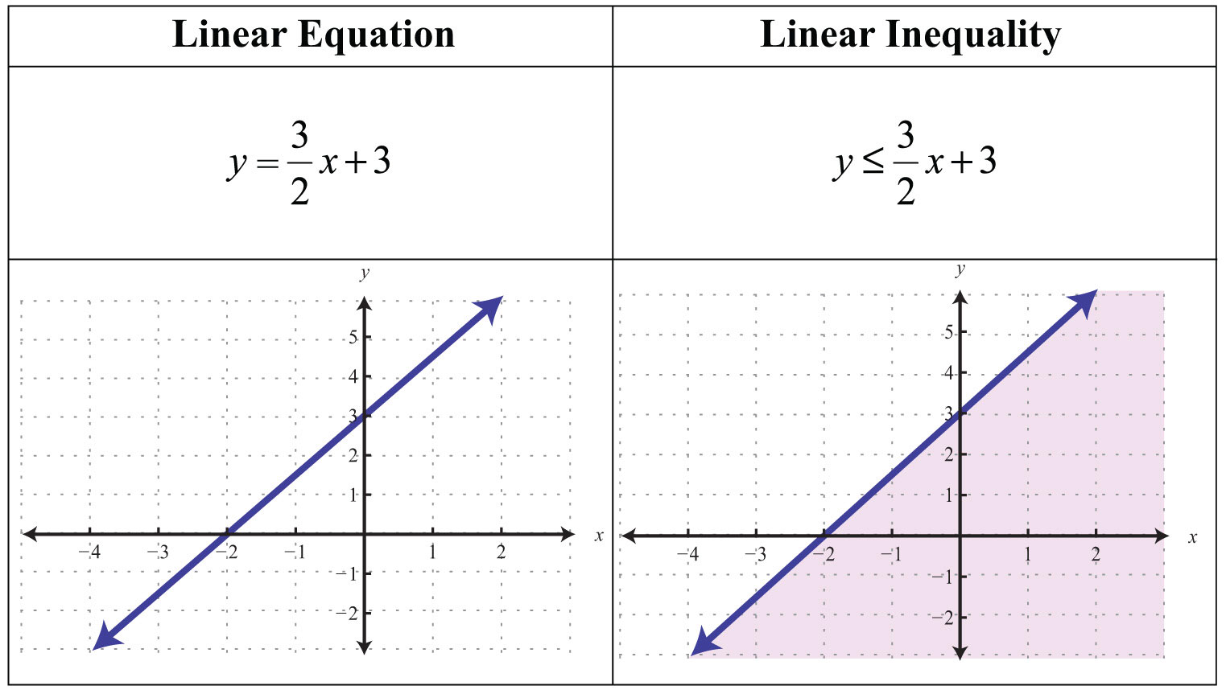
Graphing inequalities in two variables
A solution set for an inequality in two variables contains many ordered pairs when the domain and range are the set of many numbers

Slide 8
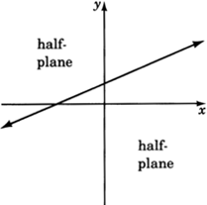
Half-plane- the region of the graph Where the solution set for an inequality in two variables is located

Slide 9
Boundary- a line or curve that separates the coordinate plane

Slide 10
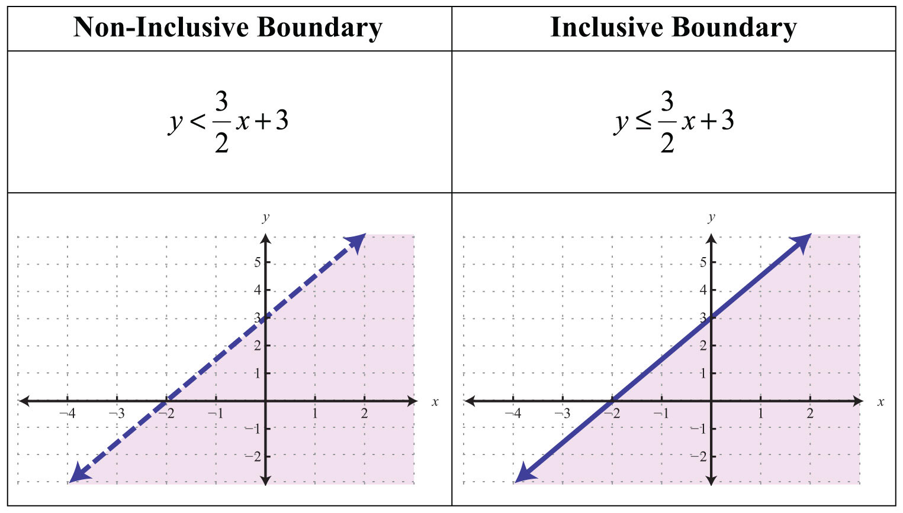
Boundary line
< or > means a dashed line
< or > means a solid line

Slide 11
Steps:
Step 1: solve for y in terms of X
Step 2: Graph the line as if it were an equality, but with either a dashed or solid line
Step 3: pick a point in one of the half-planes to test it.
Step 4: If step 3 is true, shade the Half-plane it lies in. If step 3 is false. Shade the other half-plane

Slide 12
Graph:
1 – y > X

Slide 13
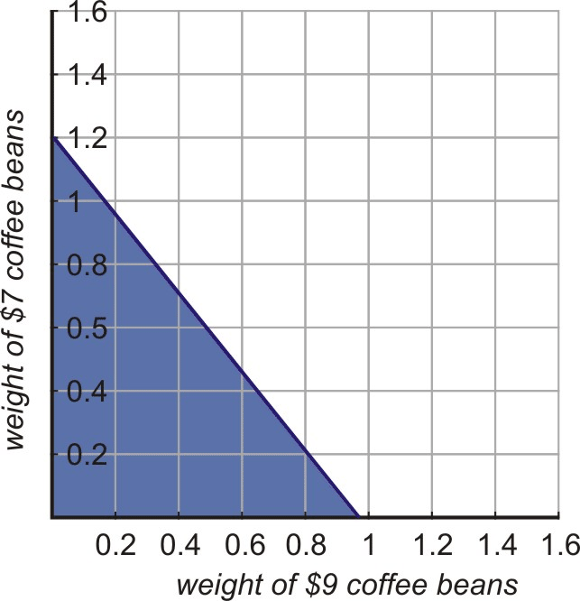
Note****
Restrictions: in real life, you can't always use negative numbers and the solutions are only in quadrant 1

